Slide 1

My Name Is Eric And I Play Thayne

Slide 2

My Name Is Kelsy And I Play Kirin

Slide 3

My Name Is Spencer And I Play Issac

Slide 4

My Name Is Alex And I Play Chuck “The Midnight” Hondooo

Slide 5
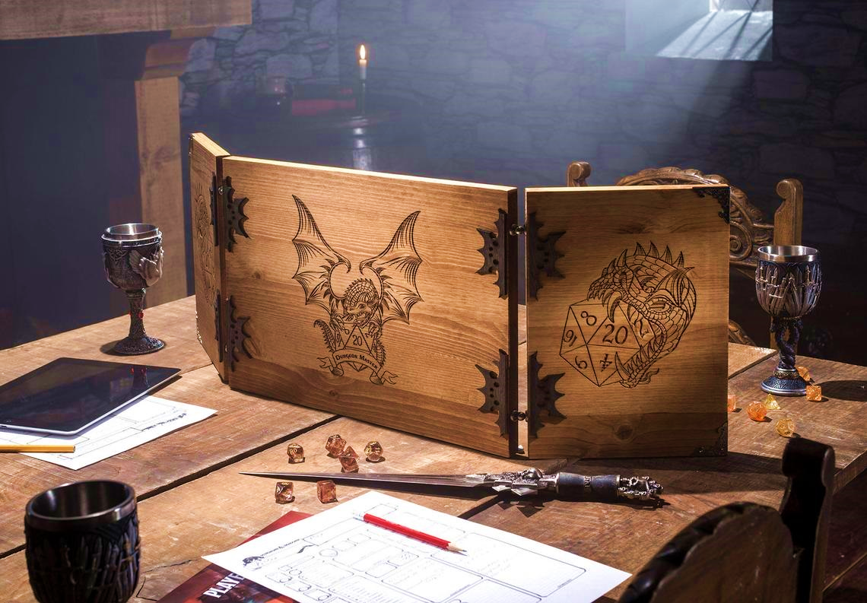
Last But Not Least, Joshua

Slide 6

Hoowee Damn Girl

Slide 7
Oh My

Slide 8
Can we end this
conversation

Slide 9
I do what’s familiar and I stab him

Slide 10
Hhhaaa…
Shit.

Slide 11
Well son of a bitch

Slide 12
Son of a dick

Slide 13
You bastard

Slide 14
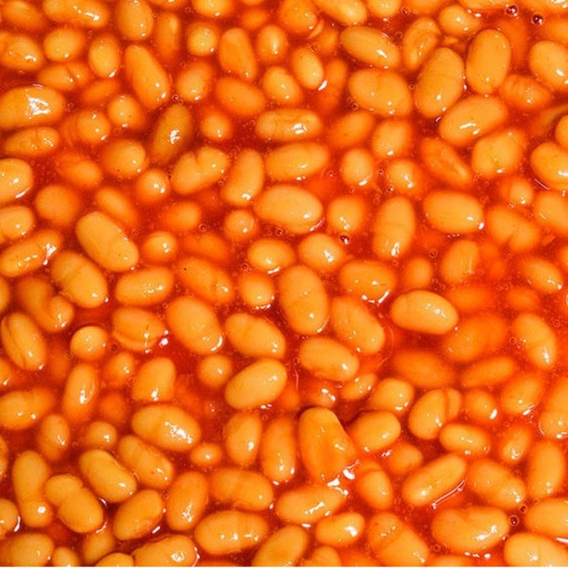
Can I have my beans now?
I answered your question

Slide 15
But that’s just not right

Slide 16
You’re gonna steal my beans

Slide 17
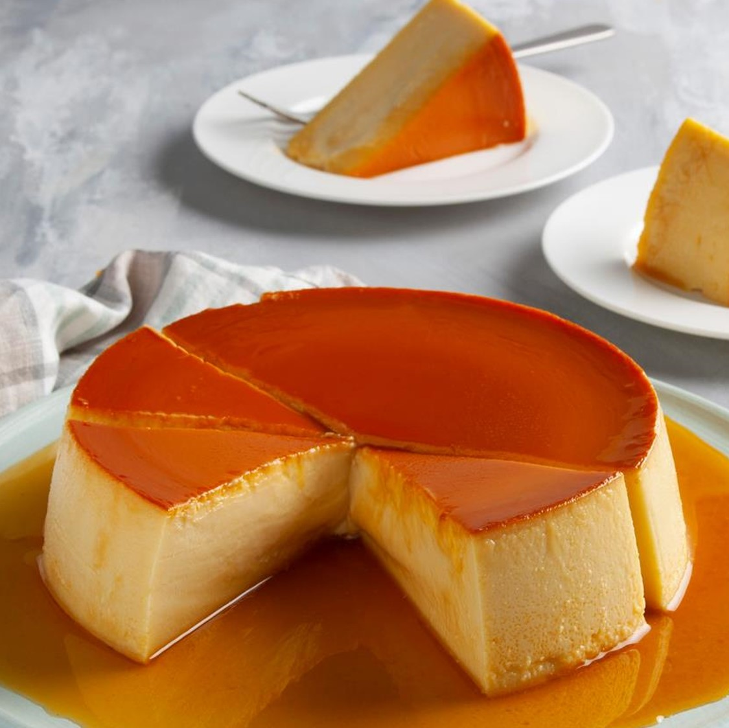
Flan

Slide 18
Flaan

Slide 19
Flaaaaan

Slide 20
Somebody’s
gonna have
to roll a
Deception
check

Slide 21
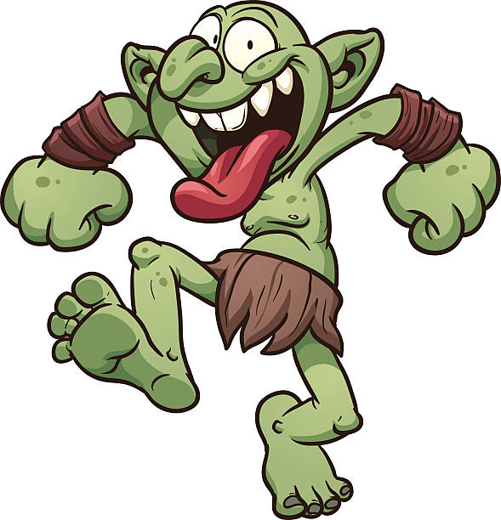
Wake up Pretty Lady

Slide 22
Pretty Lady!

Slide 23
Bubda Hungry

Slide 24
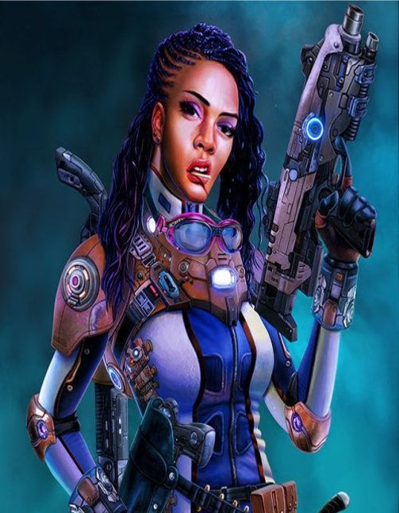
Damn You Issac

Slide 25
Oh
Hell No

Slide 26
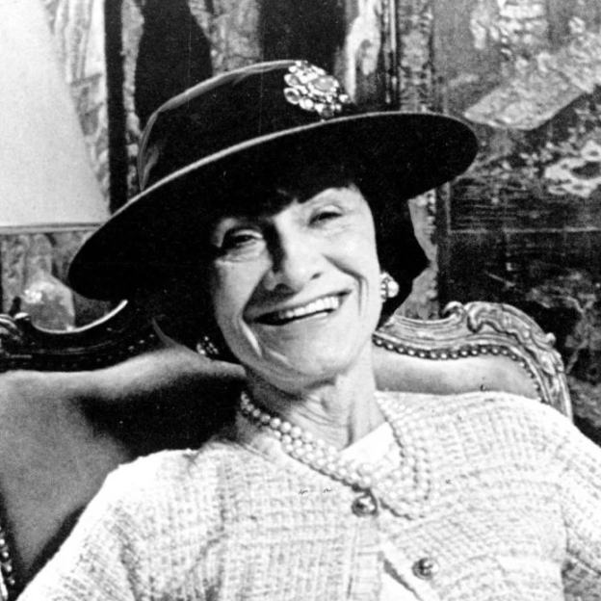
Issac
Wexler!

Slide 27
Issac
William
Wexler!

Slide 28
Undescended
Testicle

Slide 29
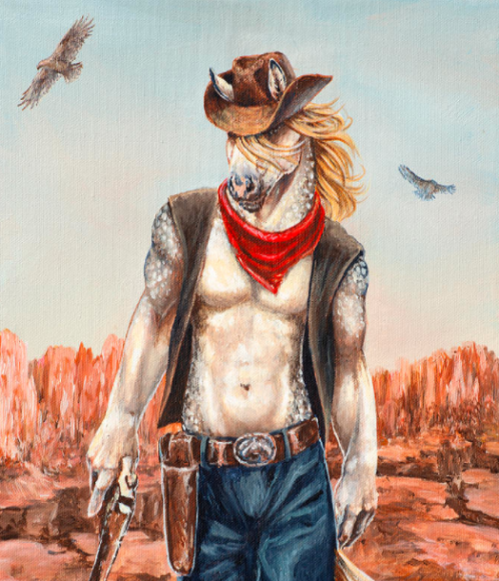
Woopty fuckin doo

Slide 30
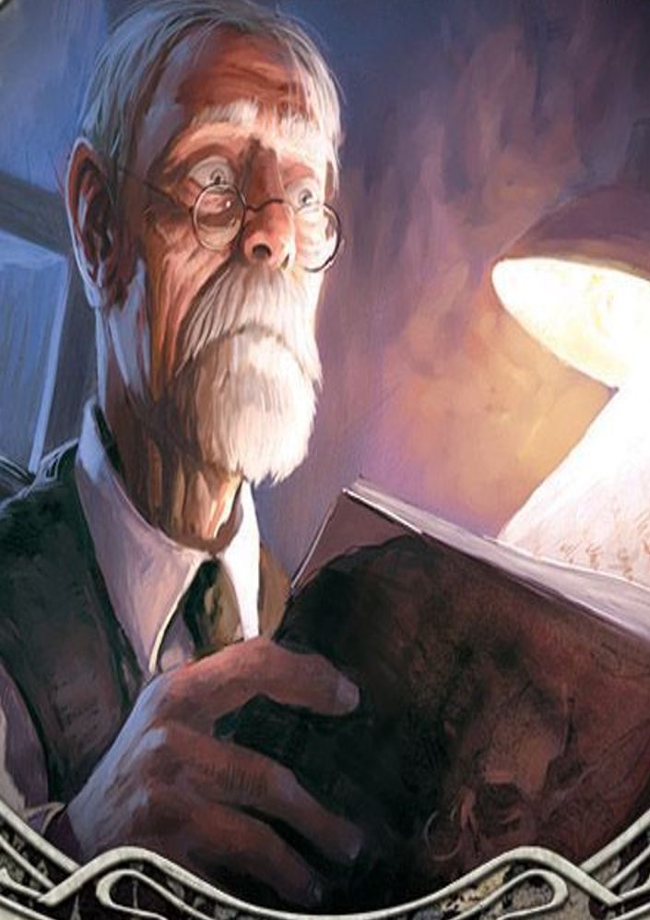
Charles!

Slide 31
Son of a biscuit weaver

Slide 32
Cheese
Whiz

Slide 33
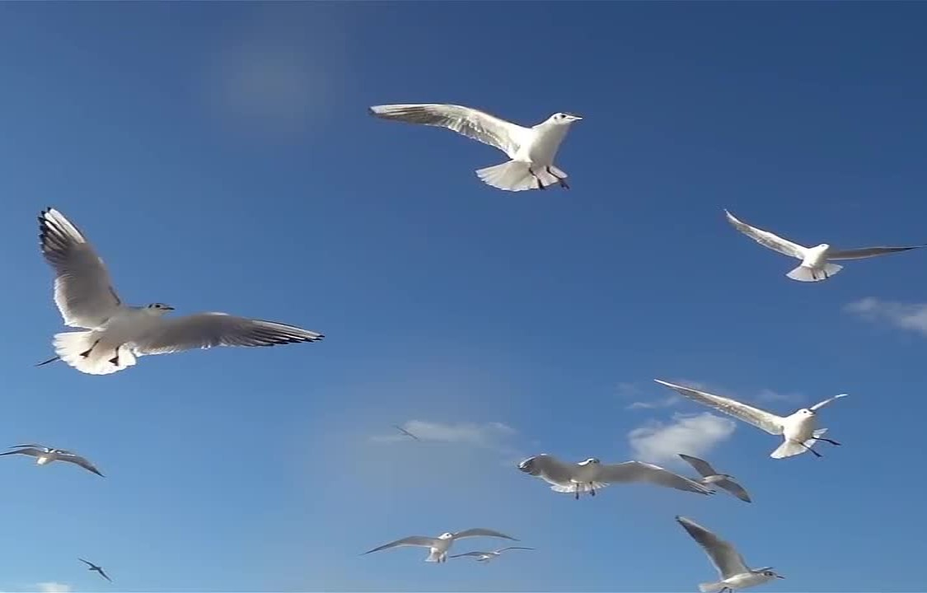
Birds, man Birds

Slide 34
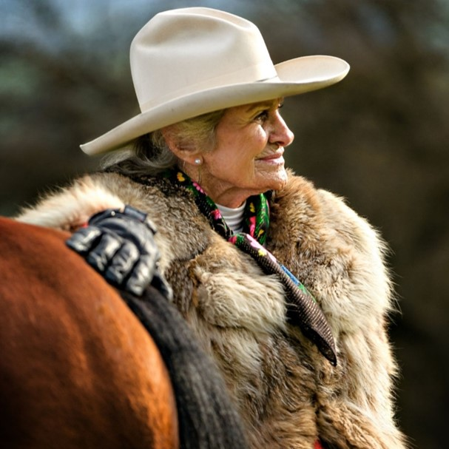
Edwina The Midnight
Hondo

Slide 35

I
Don’t
Care

Slide 36
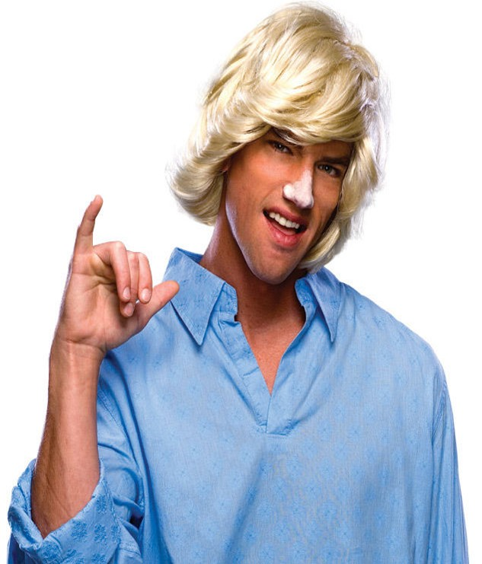
Slow down there little dudes

Slide 37
Justice, sir, that is my case

Slide 38

Ka Ka!

Slide 39
Oh yes

Slide 40

This has Wexler written all over it

Slide 41
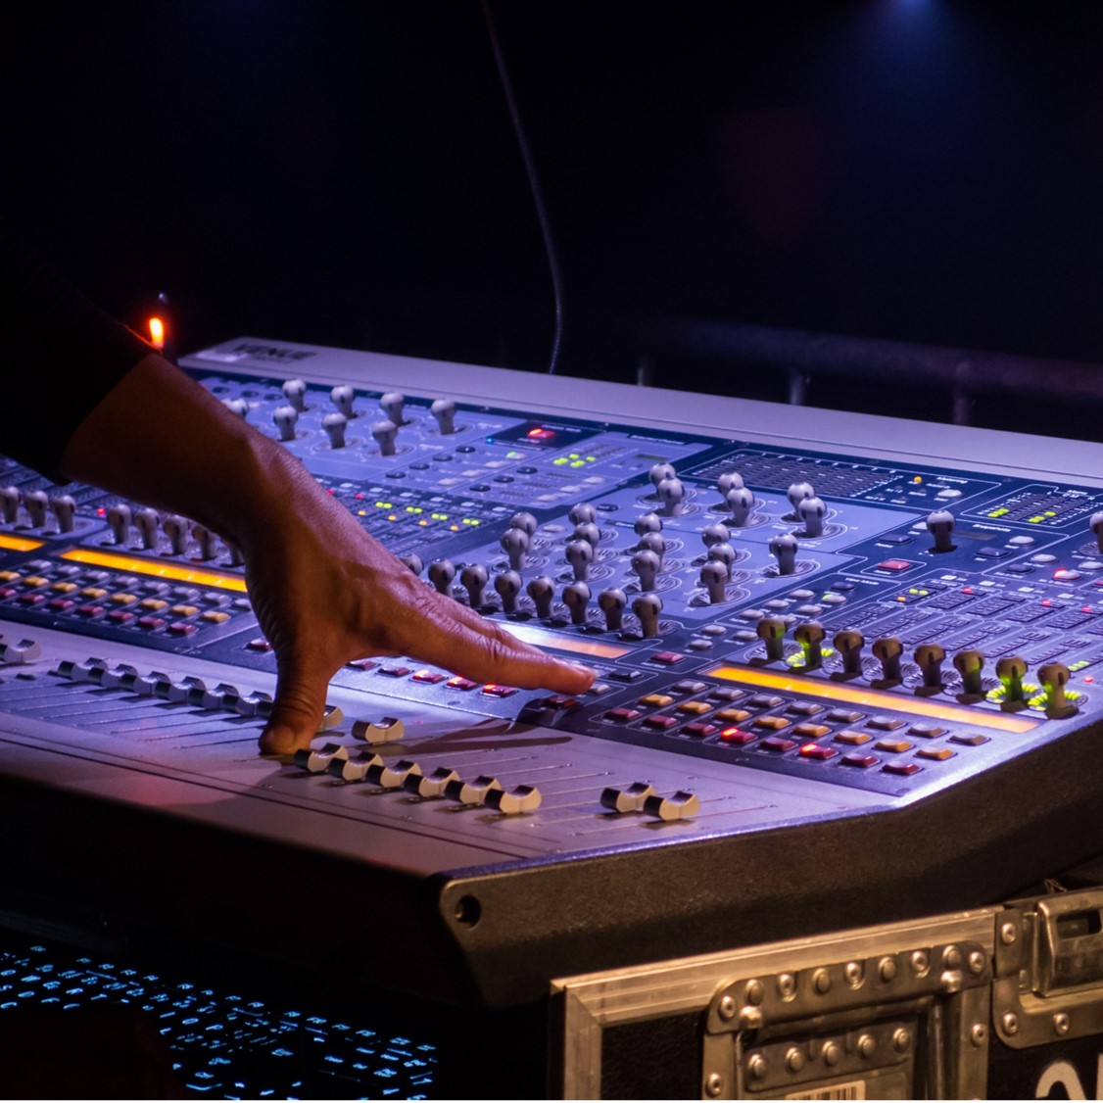
My name is John and I play Joseph McKay

Slide 42
F
You guys

Slide 43
F
You all

Slide 44
F you
Bill Alfred

Slide 45
That is not Canon

Slide 46
Kiss that mother fucker

Slide 47
Probably cut that

Slide 48
Was my joke inappropriate

Slide 49
Only one way to find out

Slide 50
I will burn your house to the ground

Slide 51
You guys have effectively ruined everything

Slide 52
I hate America

Slide 53
Oh, you’re dead

Slide 54
Are you gonna come
or not

Slide 55
Sex
Sex
Sex

Slide 56
8 damage to baby

Slide 57
Can we just eject him into space

Slide 58
No
Nooo

Slide 59
What happens in Canky Wampus

Slide 60
Unicorns are for little girls

Slide 61
But my sperm

Slide 62
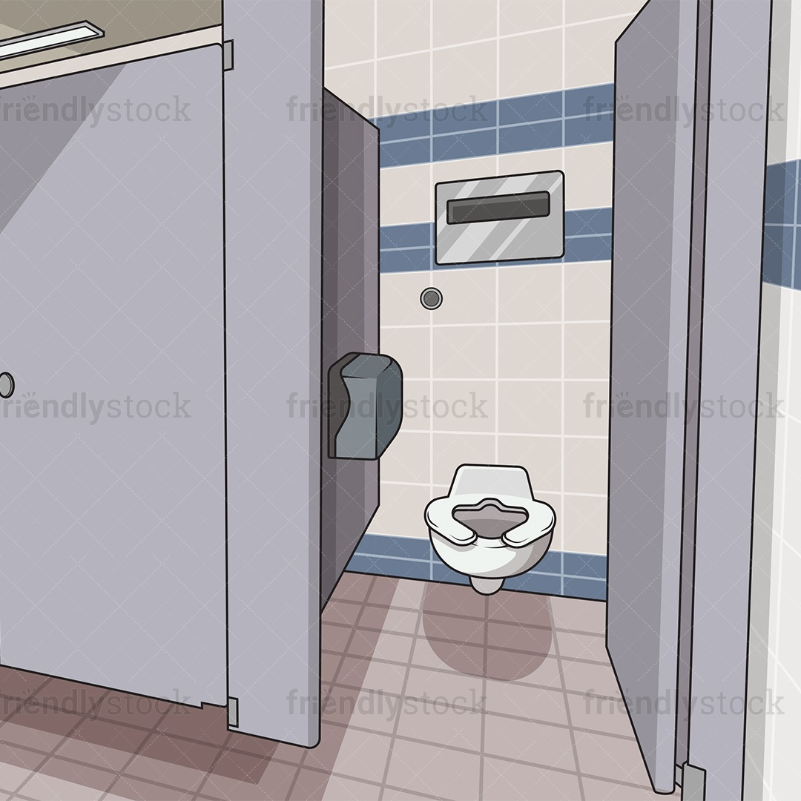
One week of toilet cleaning duty

Slide 63
Are there enough toilets?

